Slide 1
The Piano Artist
Jillian Lim

Slide 2
Main Idea
Integrate working with the microchip with sound in an interactive and fun way!

Slide 3
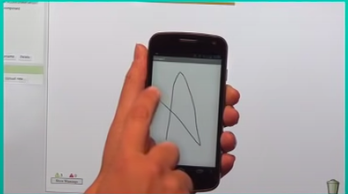
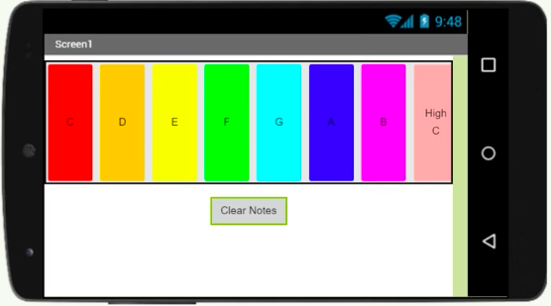
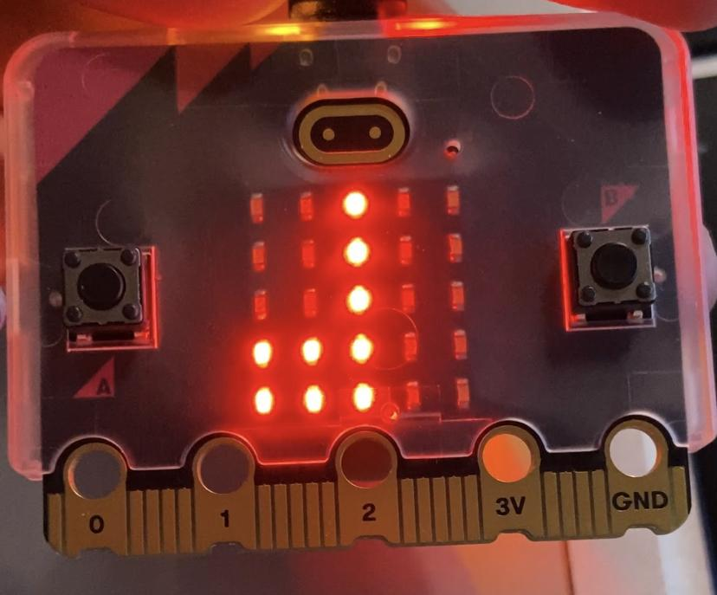
Integrating Different Projects

Slide 4
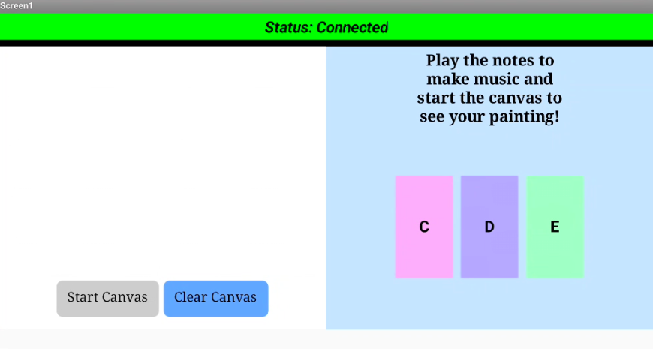

Slide 5
Main Concepts
Getting sound from the microbit while using the buttons and images
Using the piano keys to send sound to the microbit
To create random colored drawings when the piano is playing

Slide 6
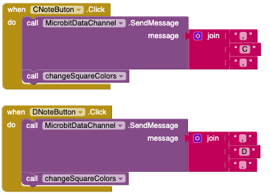
Some code
Sending a message to the Microbit when the note is pressed
Calling the change square colors procedure

Slide 7
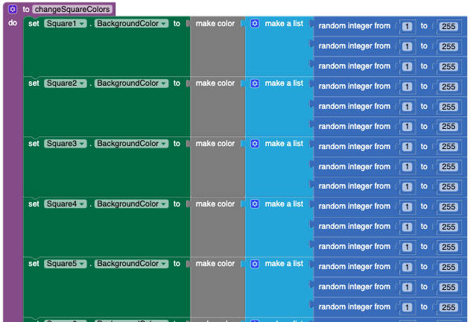
More code
Creating a procedure to change square colors
Using a list to create a random color
Using random from 1 to 255 for r,g,b values

Slide 8
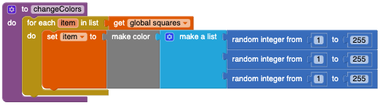
Simplify code

Slide 9
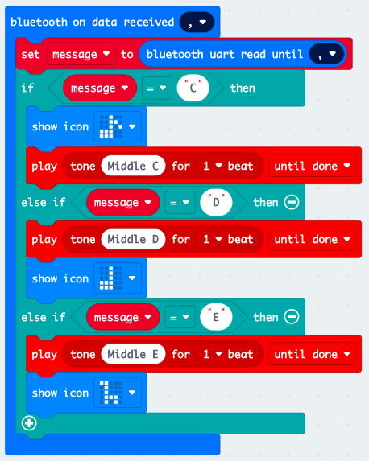
Microbit
Detect message using an if-else if-else if statement to determine which note to play
Show the icon (for fun!)
Play the note for 1 beat for every time the button is pressed

Slide 10
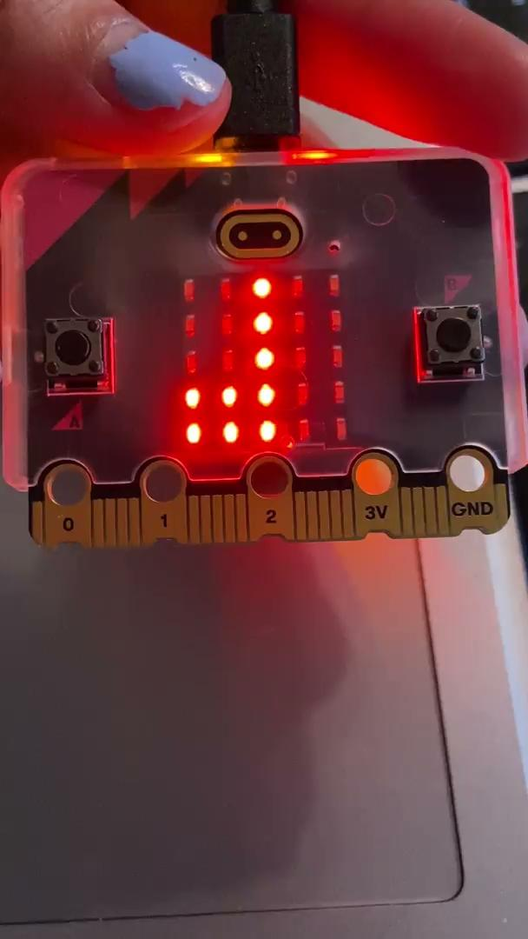

Slide 11


